Slide 1
Optimizing Hospital Supply Chain Inventory: Insights into Stock Management and Restocking Efficiency by-Abhinav Rawat

Slide 2
Supply Chain In Hospitals
A hospital's supply chain is a complex network of systems, people, and processes that work together to ensure the timely delivery of medical supplies, equipment, and pharmaceuticals. Its efficient operation is crucial for patient care, staff productivity, and overall hospital performance

Slide 3
Problem Statement
In healthcare settings, maintaining an efficient and reliable supply chain is crucial to ensure that hospitals are always prepared to meet patient needs. However, managing hospital inventory can be complex due to various factors such as fluctuating demand, limited space for storage, and the need to adhere to strict regulations for medical supplies. Mismanagement of hospital supply chains can result in stock outs, overstocking, and increased costs, all of which can negatively impact patient care and hospital operations.

Slide 4
Data Summary The dataset has a shape of (500,11) which means that it contains approximately 500 rows and 11 columns. The data has the following columns.
Date
Item Type
Item ID
Item Names
Vendor ID
Current Stock
Min Required
Max Required
Avg Usage Per Day
Restock Lead Time
Unit Cost

Slide 5

Correlation Matrix

Slide 6
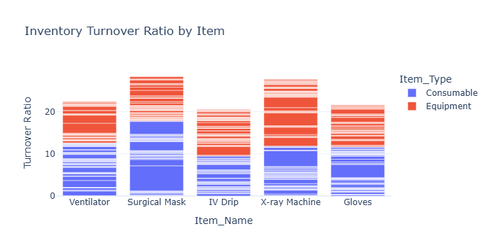
EDA Inventory Turnover Ratio by Item Type

Slide 7
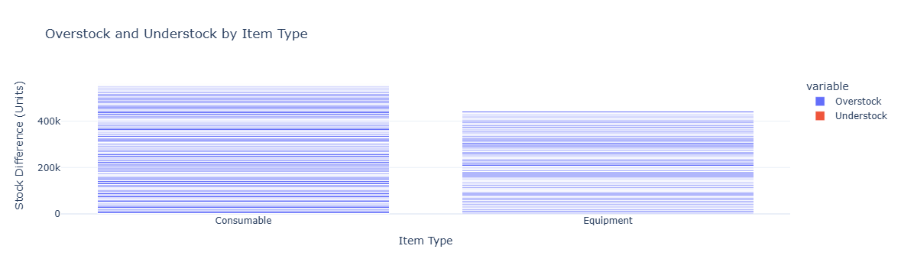
Overstock and Understock by Item Type

Slide 8
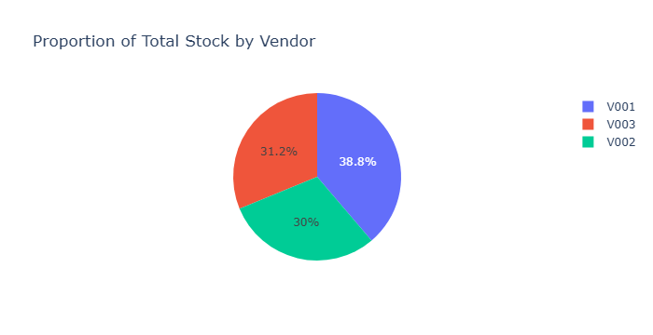
Proportion of Total Stock by Vendor

Slide 9
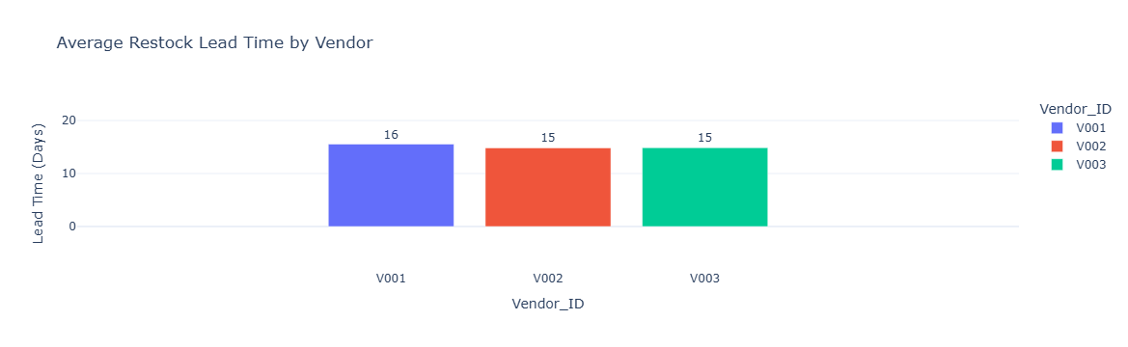
Restock Lead Time by Vendor

Slide 10
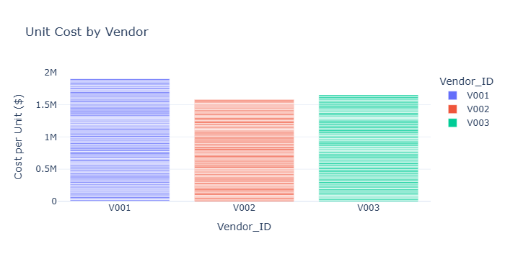
Vendor Cost Analysis

Slide 11
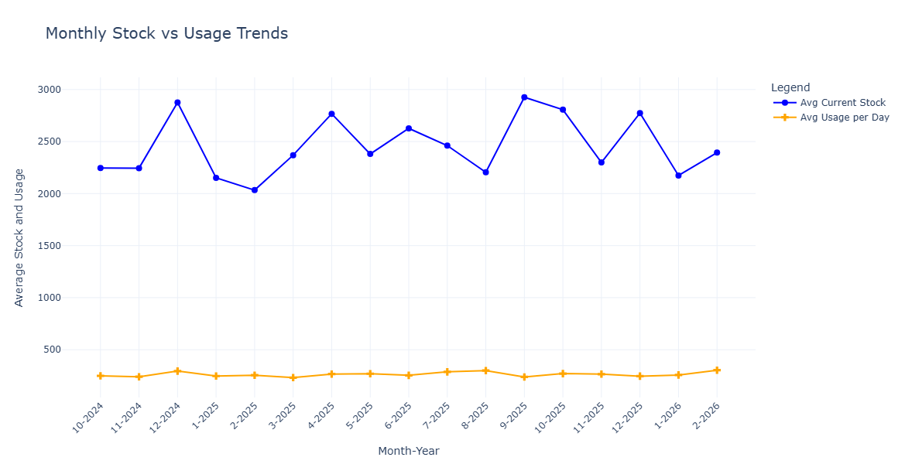
Monthly Stock And Usage Trend

Slide 12
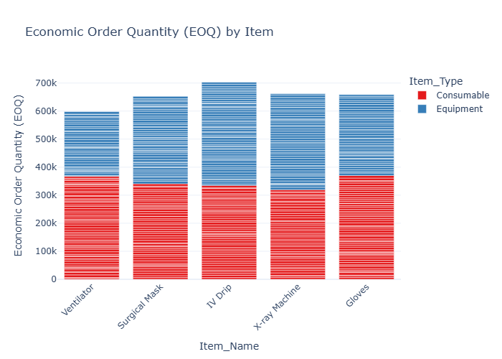
Economic Order Calculation(EOQ)

Slide 13
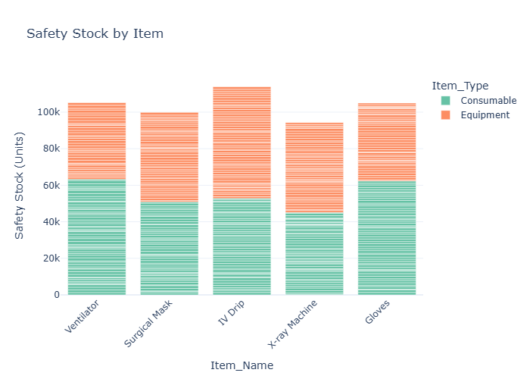
Safety Stock Calculation

Slide 14
Conclusions
Consumables have high turnover rates and are prone to overstocking, requiring precise management..
Equipment demand is stable, with lower turnover rates.
Vendor V001 accounts for the largest share of inventory but has longer lead times and higher costs, while V002 and V003 offer shorter lead times and cost-efficiency, making them preferable for critical supplies.
Monthly stock fluctuations indicate variability in planning, while daily usage remains consistent.
EOQ and safety stock calculations highlight opportunities to optimize costs and reduce stock out risks.
Strategic inventory management is essential to balance stock availability, cost efficiency, and vendor reliability.

Slide 15
Recommendation
Improve Consumables Management: Regularly adjust inventory levels based on demand patterns and maintain safety stock to prevent stock outs.
Diversify Vendors: Reduce reliance on Vendor V001 by reallocating critical supplies to other vendors and establishing backup suppliers.
Optimize Inventory Costs: Use EOQ to balance holding and ordering costs and minimize overstocking.
Enhance Vendor Contracts: Negotiate for shorter lead times and reliable performance benchmarks.

Slide 16
Thank You

